Slide 1

INFORMATION SECURITY

Slide 2
Three Pillars of Information Security
Confidentiality
Integrity
Availability
Non repudiation
Authenticity
Accountability

Slide 3
Triads of Confidentiality
Confidentiality - means information is not disclosed to unauthorized individuals, entities and process
Integrity - means maintaining accuracy and completeness of data. This means data cannot be edited in an unauthorized way.
Availability -means information must be available when needed.
Non repudiation – means one party cannot deny receiving a message or a transaction nor can the other party deny sending a message or a transaction. Data Integrity and Authenticity are pre-requisites for Non repudiation.
Authenticity – means verifying that users are who they say they are and that each input arriving at destination is from a trusted source.
Accountability – means that it should be possible to trace actions of an entity uniquely to that entity.

Slide 4


Slide 5


Slide 6
NATURAL
WHOLE
INTEGERS
RATIONAL
NUMBERS

Slide 7
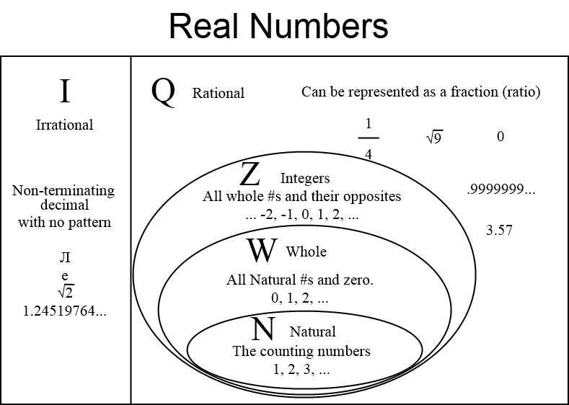

Slide 8
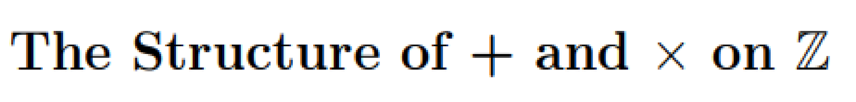
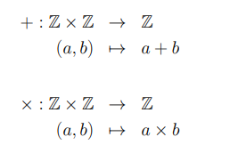
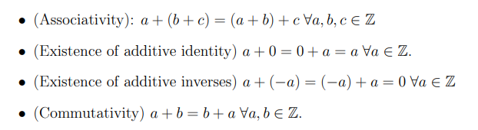
Properties of +:

Slide 9
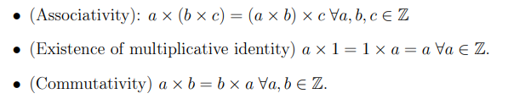
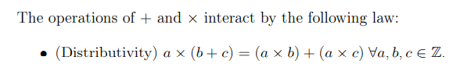
Properties of x:

Slide 10
Properties of Q
All of the above hold for + and × on Q
Also non-zero elements have multiplicative inverses:
a, b ∈ Z such that ab = 0 ⇒ either a = 0 or b = 0 ⇒. Z is an integral domain
Properties of Z

Slide 11
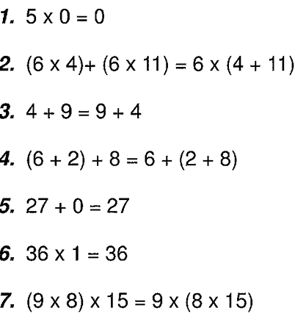
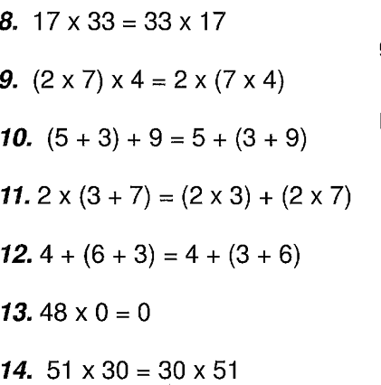
PROPERTIES OF NUMBERS

Slide 12

Abstract Algebra
Branch of mathematics
Algebraic concepts are generalized by using symbols
Represent basic arithmetical operations
Abstract algebra - set of advanced topics of algebra that deal with abstract algebraic structures
Groups, rings, and fields.

Slide 13
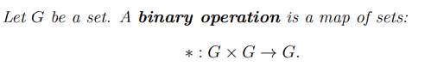

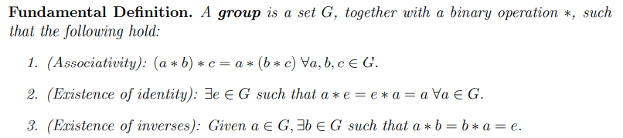
Groups
Examples: (Z, +), (Q, +), (Q\{0}, ×), (Z/mZ, +), and (Z/mZ \ {[0]}, ×) if m is prime.
(Z, ×) is not a group.

Slide 14
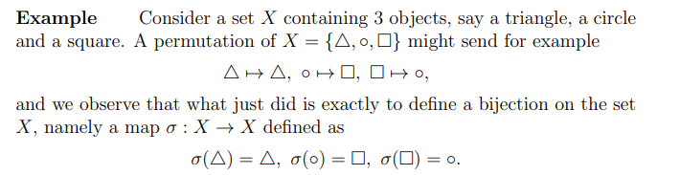
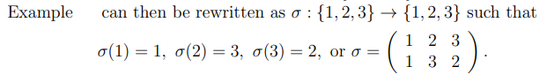
Permutation group
A permutation of a set X is a function σ : X → X that is one-to-one and onto.

Slide 15
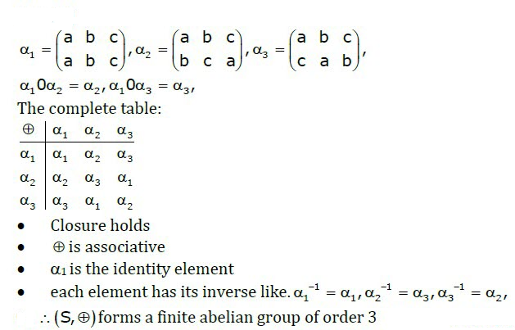
Permutation group

Slide 16
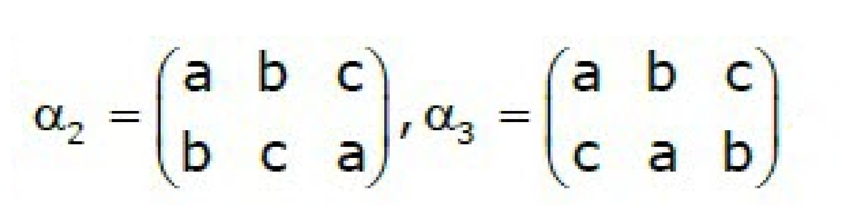
Commutativity property

Slide 17
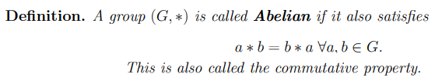
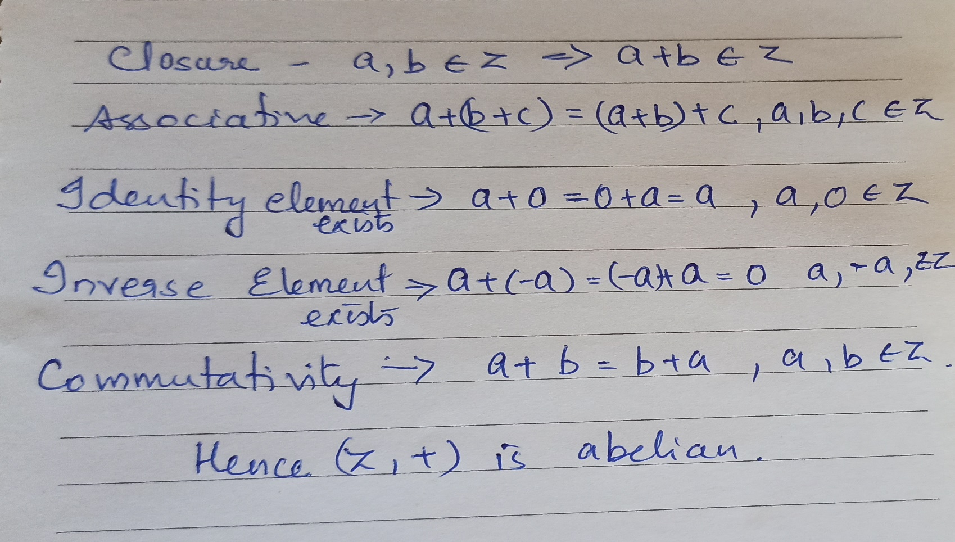
ABELIAN Groups

Slide 18
Prove that x*y = x+y+k is an abelian group on set R of real numbers, where k is a fixed constant.
Closure: x∗y=x+y+k (k is a fixed constant), on the set RR of the real numbers.
x∗y=x+y+k=y+x+k=y∗x. Commutativity holds.
(x∗y)∗z=(x+y+k)∗z=(x+y+k)+z+k=(z+y+k)+x+k=x∗(y∗z). Associativity holds.
x∗e=x+e+k=x, so e=−k.
Further, e∗x=−k+x+k=x. Thus e is an identity.
x∗x′=x+x′+k=e, so x′=e−x−k.
Further, x′∗x=e−x−k+x+k=e. Thus, x′ is an inverse element.
This set is an Abelian Group.

Slide 19
Prove that x*y = x+y+k is an abelian group on set R of real numbers, where k is a fixed constant.

Slide 20
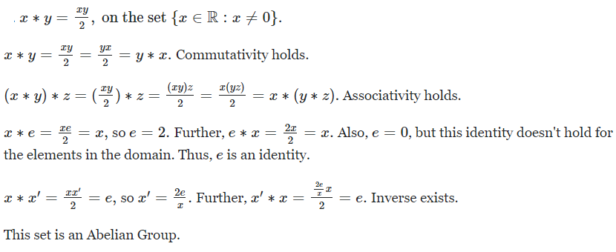
Prove that
is an abelian group

Slide 21
CYCLIC Groups
Example: ({1,-1,i,-i},x)
Each element can be written as a power of a in multiplicative notation, or as a multiple of a in additive notation. This element a is called the generator of the group.
Closure
Associativity
Identity
Inverse
Generator

Slide 22
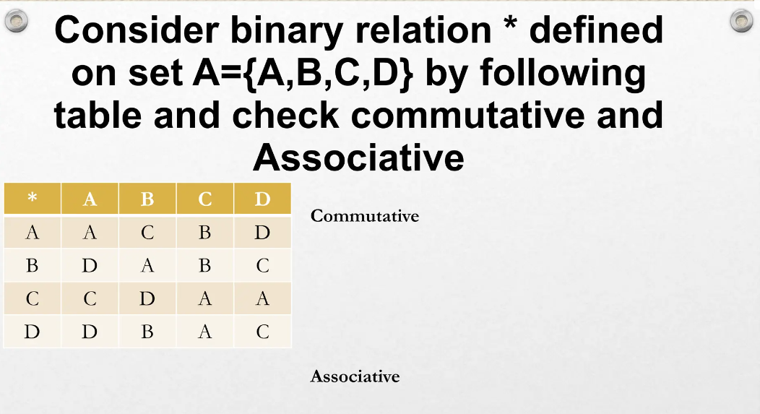

Slide 23
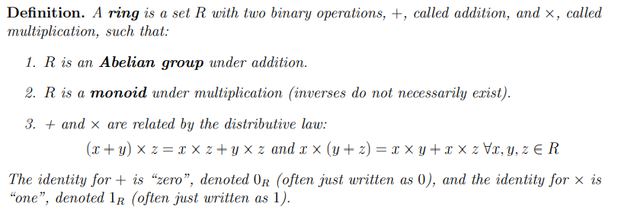
rings
Example: The integers under the usual addition and multiplication (Z, x, +).
Set of n-square matrices over Real numbers
Commutative Ring: a ⋅ b = b ⋅ a for all a, b in R, Eg: Z_{n} , arithmetic operations Modulo n

Slide 24
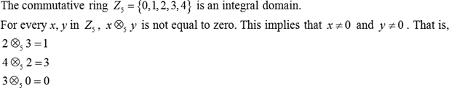
Integral domain
An integral domain is a nonzero commutative ring in which the product of any two nonzero elements is nonzero.
A commutative Ring that follows the axioms:
Multiplicative identity: There is an element 1 in R such that a1 = 1a = a for all a in R.
No zero divisors: If a, b in R and ab = 0, then either a = 0 or b = 0.
Example:

Slide 25
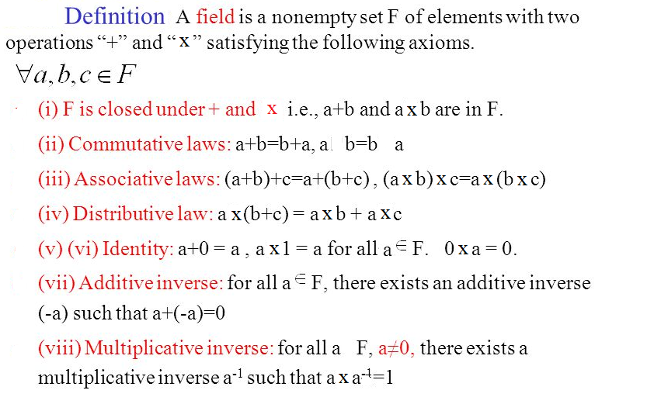

fields
x
x

Slide 26
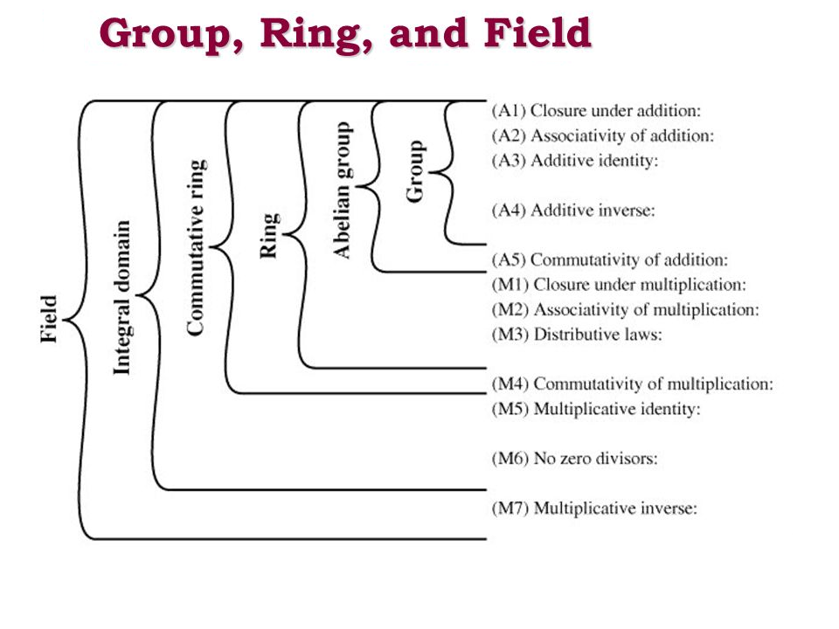

Slide 27
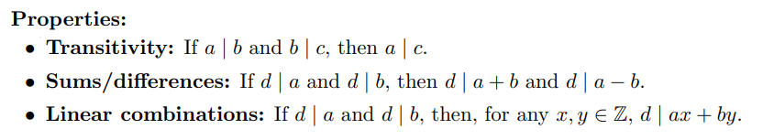
Introduction to number theory
Divisibility :
a|b => a divides b

Slide 28
Divisors
say a non-zero number b divides a if for some m have a=mb (a,b,m all integers)
that is b divides into a with no remainder
denote this b|a
and say that b is a divisor of a
eg. all of 1,2,3,4,6,8,12,24 divide 24
Notes:
Define concept of “divisors”. We say that a nonzero b divides a if a=m.b for some m, where a, b, and m are integers. That is, b divides a if there is no remainder on division. Can denote this as b|a, and say that b is a divisor of a. For example, the positive divisors of 24 are 1,2,3,4,6,8,12, and 24.

Slide 29
Division algorithm
Given any positive integer n and any integer a, if we divide a by n , we get an integer quotient, q and integer remainder r that obey the following relationship:
a= qn+ r, 0<r<n; q=a/n
Example:
a= 11, n = 7 => 11=1x7 + 4 i.e. q=1, r=4
a=-11, n= 7 => -11 = (-2) 7 + 3 i. e q= -2, r=3

Slide 30
Modular Arithmetic
Modulo is the operation of finding the Remainder when you divide two numbers.
define modulo operator “a mod n” to be remainder when a is divided by n
r is called a residue of a mod n
since with integers can always write: a = qn + r => a = qn+ (a mod n)
usually chose smallest positive remainder as residue
ie. 0 <= r <= n-1
Eg: 11mod 7 = 4 & -11 mod 7 = 3
Two integers are said to be congruent modulo n,
if (a mod n ) = (b mod n) => a = b (mod n )
when divided by n, a & b have same remainder
eg. 100 = 34 mod 11
modulo reduction
eg. -12 mod 7 = -5 mod 7 = 2 mod 7 = 9 mod 7
Notes:
Given any positive integer n and any nonnegative integer a, if we divide a by n, we get an integer quotient q and an integer remainder r. In modular arithmetic we are only interested in the remainder (or residue) after division by some modulus, and results with the same remainder are regarded as equivalent. Two integers a and b are said to be congruent modulo n, if (a mod n) =(b mod n).

Slide 31
Greatest Common Divisor (GCD)
GCD (a,b) of a and b is the largest number that divides evenly into both a and b
eg GCD(60,24) = 12
When we have no common factors (except 1), the numbers are relatively prime
eg GCD(8,15) = 1
hence 8 & 15 are relatively prime
Notes:
One of the basic techniques of number theory is the Euclidean algorithm, which is a simple procedure for determining the greatest common divisor of two positive integers. Use the notation gcd(a,b) to mean the greatest common divisor of a and b. The positive integer c is said to be the greatest common divisor of a and b if c is a divisor of a and of b; and any divisor of a and b is a divisor of c.
State that two integers a and b are relatively prime if their only common positive integer factor is 1, ie GCD(a,b)=1.

Slide 32
Euclidean Algorithm
an efficient way to find the GCD(a,b)
uses theorem that:
GCD(a,b) = GCD(b, a mod b)
Euclidean Algorithm to compute GCD(a,b) is:
EUCLID(a,b)
1. A = a; B = b
2. if B = 0 return A = gcd(a, b)
3. R = A mod B
4. A = B
5. B = R
6. goto 2
Notes:
The Euclidean algorithm is an efficient way to find the GCD(a,b). The Euclidean algorithm is derived from the observation that if a & b have a common factor d (ie. a=m.d & b=n.d) then d is also a factor in any difference between them, vis: a-p.b = (m.d)-p.(n.d) = d.(m-p.n). Euclid's Algorithm keeps computing successive differences until it vanishes, at which point the greatest common divisor has been reached.

Slide 33
Example GCD(1970,1066)
1970 = 1 x 1066 + 904 gcd(1066, 904)
1066 = 1 x 904 + 162 gcd(904, 162)
904 = 5 x 162 + 94 gcd(162, 94)
162 = 1 x 94 + 68 gcd(94, 68)
94 = 1 x 68 + 26 gcd(68, 26)
68 = 2 x 26 + 16 gcd(26, 16)
26 = 1 x 16 + 10 gcd(16, 10)
16 = 1 x 10 + 6 gcd(10, 6)
10 = 1 x 6 + 4 gcd(6, 4)
6 = 1 x 4 + 2 gcd(4, 2)
4 = 2 x 2 + 0 gcd(2, 0)
Hence gcd(1970,1066) = 2
Notes:
Illustrate how we can compute successive instances of GCD(a,b) = GCD(b,a mod b), example taken from text.
Note this MUST always terminate since will eventually get a mod b = 0 (ie no remainder left).
Answer is then the last non-zero value. In this case GCD(1970,1066)=2.

Slide 34
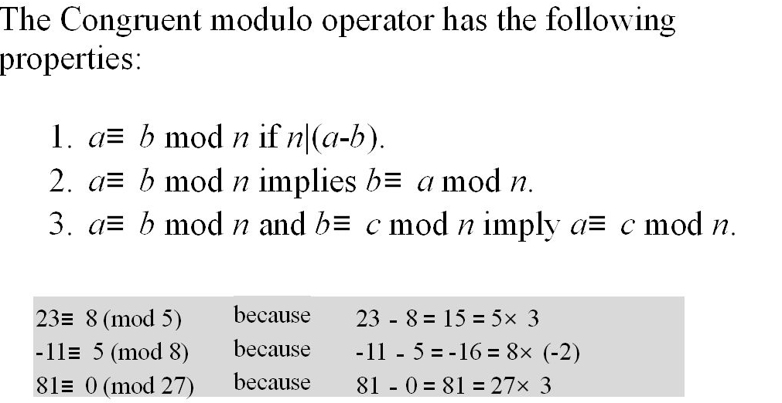
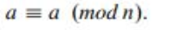
Properties of congruent modulo
Symmetric Property
Transitive Property
4.
Reflexive Property
Notes:
Modular arithmetic is where we perform arithmetic operations within the confines of some set of integers mod n. It uses a finite number of values, and loops back from either end where needed.
When reducing, we "usually" want to find the positive remainder after dividing by the modulus. For positive numbers, this is simply the normal remainder. For negative numbers we have to "overshoot" (ie find the next multiple larger than the number) and "come back" (ie add a positive remainder to get the number); rather than have a "negative remainder".
Then note some important properties of modular arithmetic which mean you can modulo reduce at any point and obtain an equivalent answer.

Slide 35
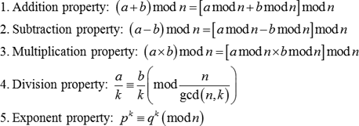
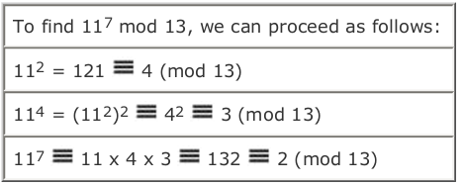
Properties of Modular Arithmetic
a^{k}(modn)=(a(modn))^{k}
Notes:
Note some more important properties of modular arithmetic, as discussed further in the text.

Slide 36
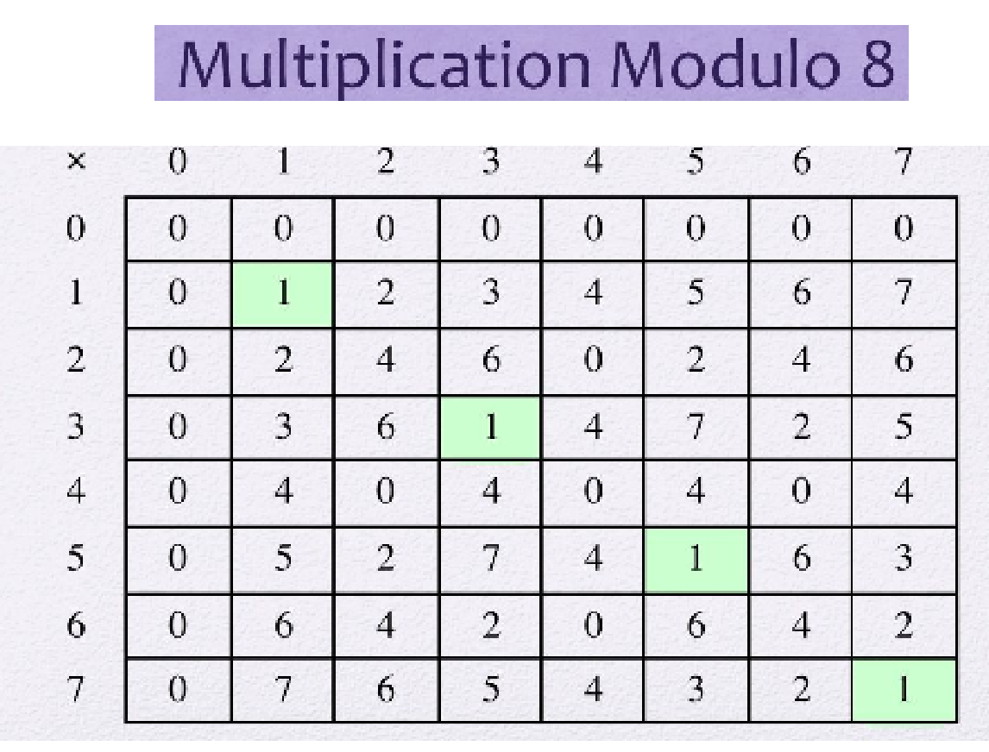
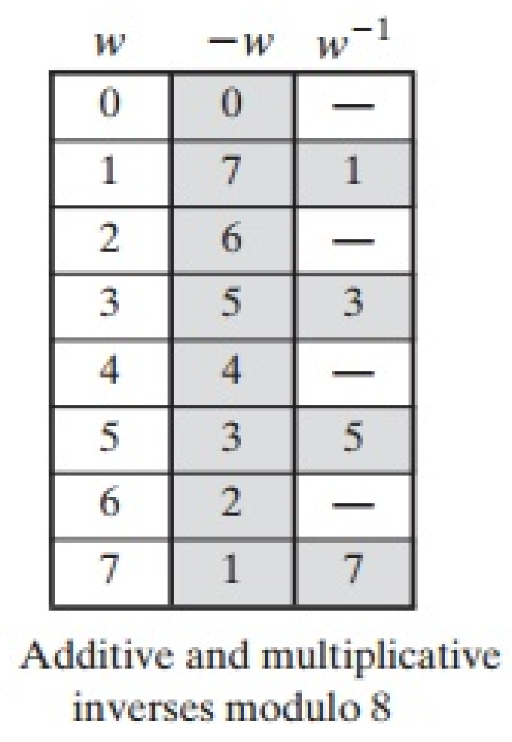

Addition Modulo 8
Z₈ = {0,1,2,3,4,5,6,7} is a set of residues or residue classes (mod 8)
+ | 0 | 1 | 2 | 3 | 4 | 5 | 6 | 7
0 | 0 | 1 | 2 | 3 | 4 | 5 | 6 | 7
1 | 1 | 2 | 3 | 4 | 5 | 6 | 7 | 0
2 | 2 | 3 | 4 | 5 | 6 | 7 | 0 | 1
3 | 3 | 4 | 5 | 6 | 7 | 0 | 1 | 2
4 | 4 | 5 | 6 | 7 | 0 | 1 | 2 | 3
5 | 5 | 6 | 7 | 0 | 1 | 2 | 3 | 4
6 | 6 | 7 | 0 | 1 | 2 | 3 | 4 | 5
7 | 7 | 0 | 1 | 2 | 3 | 4 | 5 | 6
Notes:
Example showing addition in GF(8), from Stallings Table 4.1a.

Slide 37
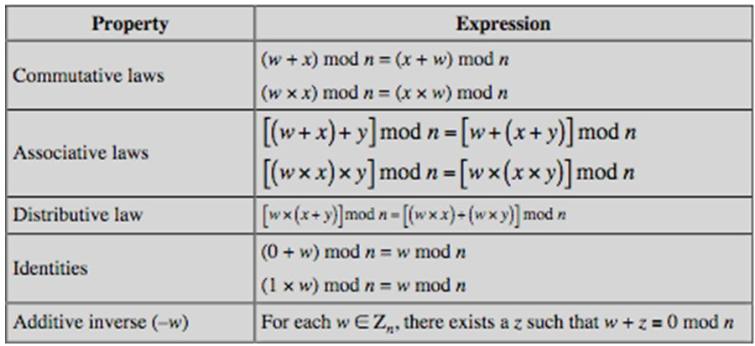
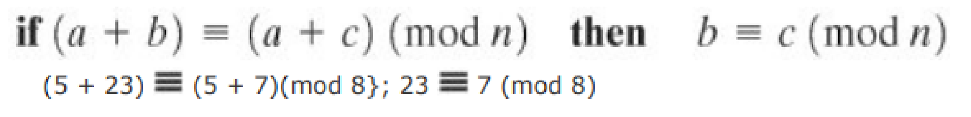
Properties of Modular Arithmetic for Integers in Zn

Slide 38
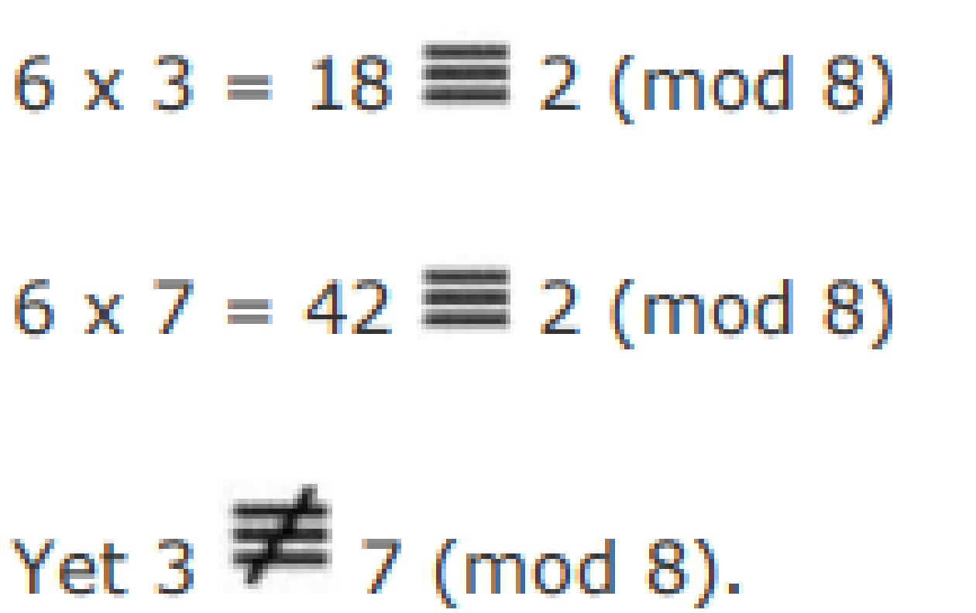
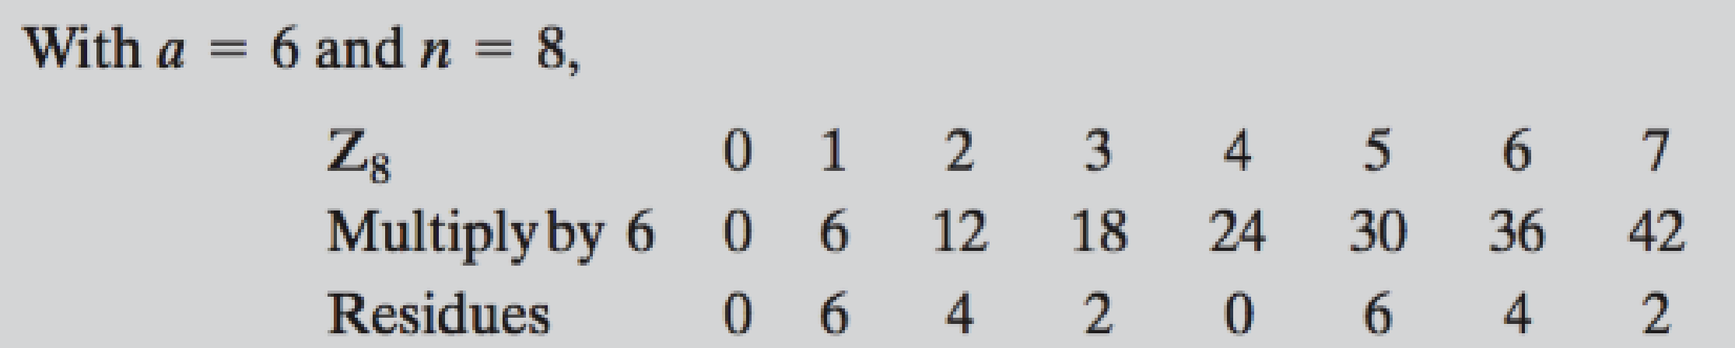
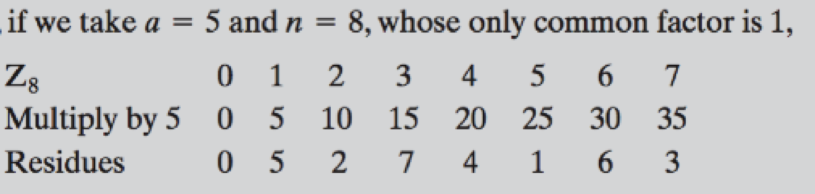
If (axb)= (axc)(mod n) then b = c (mod n), if a is relatively prime to n.

Slide 39
Galois Fields
F I e l d s
Examples of field: R, C, Q ;
Z is not a field coz no inverse for all elements.
Fields => Finite / Infinite
A finite field is a field that contains a finite number of elements
Finite fields play a key role in cryptography
The number of elements in a finite field must be a power of a prime p^{n}
known as Galois fields
denoted GF(p^{n})
in particular often use the fields: GF(p), GF(2^{n})
Notes:
Infinite fields are not of particular interest in the context of cryptography. However, finite fields play a crucial role in many cryptographic algorithms. It can be shown that the order of a finite field (number of elements in the field) must be a positive power of a prime, & these are known as Galois fields & denoted GF(p^n). We are most interested in the cases where either n=1 - GF(p), or p=2 - GF(2^n).

Slide 40
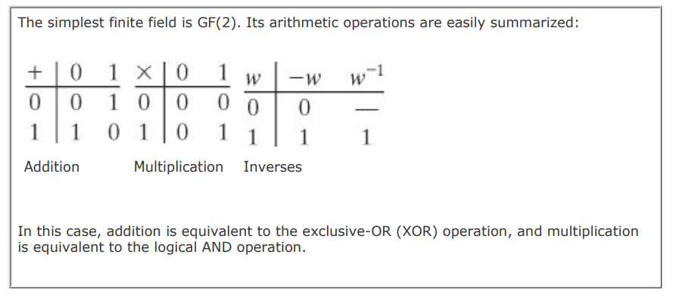
Galois Fields
GF(p) is the set of integers {0,1, … , p-1} with arithmetic operations modulo prime p
These form a finite field since have multiplicative inverses
Hence arithmetic is “well-behaved” and can do addition, subtraction, multiplication, and division without leaving the field GF(p)

Slide 41
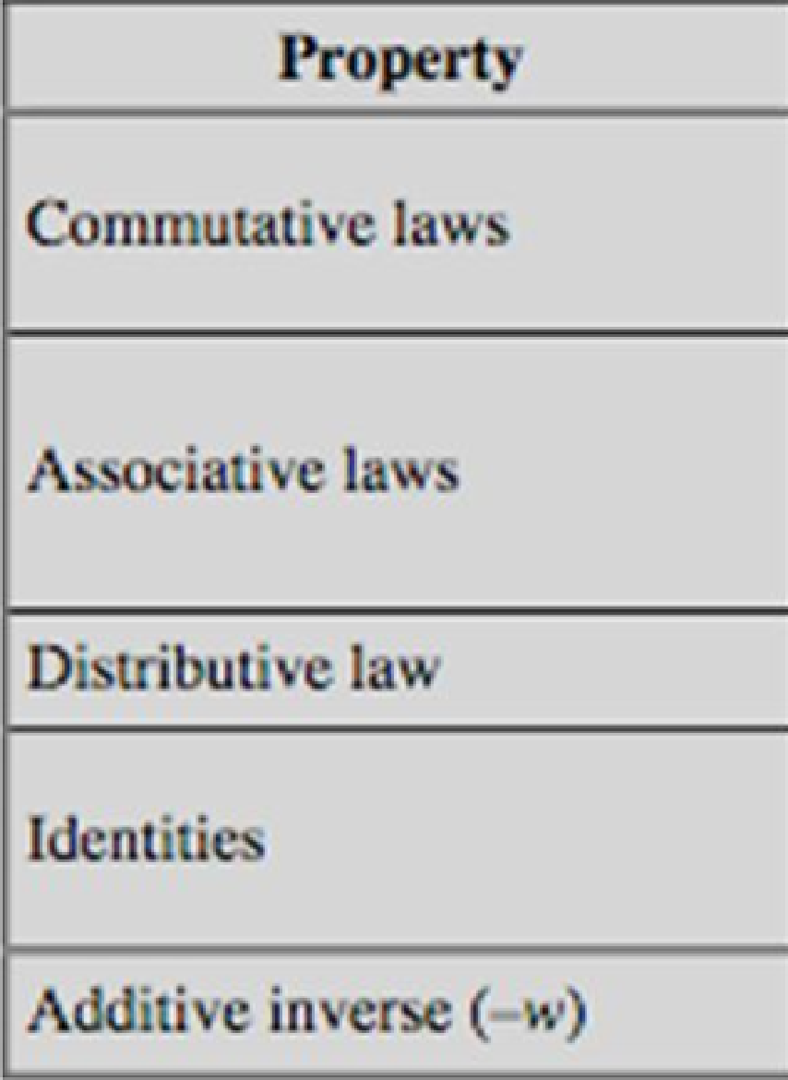
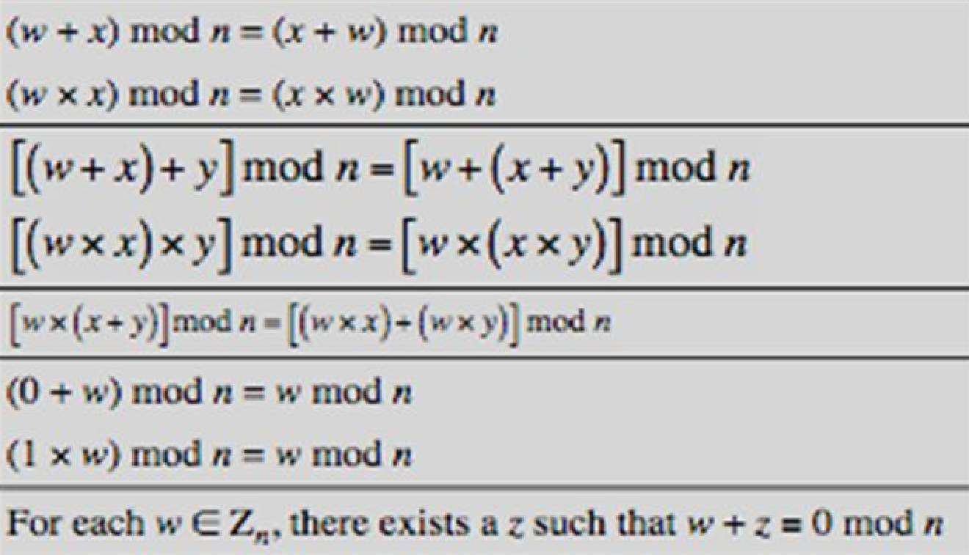

GF(7) Multiplication Example
× | 0 | 1 | 2 | 3 | 4 | 5 | 6
0 | 0 | 0 | 0 | 0 | 0 | 0 | 0
1 | 0 | 1 | 2 | 3 | 4 | 5 | 6
2 | 0 | 2 | 4 | 6 | 1 | 3 | 5
3 | 0 | 3 | 6 | 2 | 5 | 1 | 4
4 | 0 | 4 | 1 | 5 | 2 | 6 | 3
5 | 0 | 5 | 3 | 1 | 6 | 4 | 2
6 | 0 | 6 | 5 | 4 | 3 | 2 | 1
This is a field of order 7 using modular arithmetic modulo 7.
Z8 using modular arithmetic modulo 8, is not a field
Notes:
Example showing multiplication in GF(7), from Stallings Table 4.3b.

Slide 42
Extended Euclidean algorithm
The Extended Euclidean Algorithm computes the gcd(a,b) and also the values of integers x and y that satisfies the relation
ax + by = d = gcd(a,b)
If a & b are relatively prime to each other, gcd(a,b) = 1
=> ax + by =1
(ax + by)mod a = 1moda
=> ((ax mod a) +(bymoda)moda) = 1mod a
=> (0 + by mod a ) mod a = 1mod a
=> by mod a = 1
by = 1mod a
=> y = b⁻¹

Slide 43
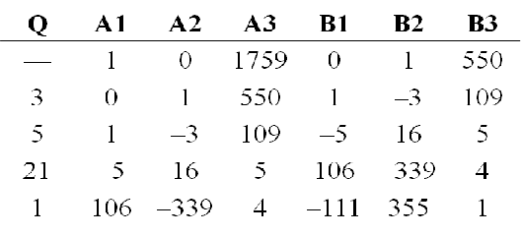
Finding Inverses
Inverse of 550 in GF(1759)
EXTENDED EUCLID(m, b)
1. (A1, A2, A3)=(1, 0, m);
(B1, B2, B3)=(0, 1, b)
2. if B3 = 0
return A3 = gcd(m, b); no inverse
3. if B3 = 1
return B3 = gcd(m, b); B2 = b^{–1} mod m
4. Q = A3 div B3
5. (T1, T2, T3)=(A1–QB1,A2–QB2,A3–QB3)
6. (A1, A2, A3)=(B1, B2, B3)
7. (B1, B2, B3)=(T1, T2, T3)
8. goto 2
The Euclidean algorithm can be extended so that, in addition to finding gcd(m, b), if the gcd is 1, the algorithm returns the multiplicative inverse of b.
Notes:
An important problem is to find multiplicative inverses in such finite fields. Can show that such inverses always exist, & can extend the Euclidean algorithm to find them as shown. See text for discussion as to why this works.

Slide 44
Polynomial Arithmetic
use polynomials
f(x) = a_{n}x^{n} + a_{n-1}x^{n-1} + … + a₁x + a₀ = ∑ a_{i}x^{i}
not interested in any specific value of x
several alternatives available
ordinary polynomial arithmetic
poly arithmetic with coefficients mod p (coeff in GF(p))
poly arithmetic with coeffs mod p (coeff in GF(p))
and polynomials mod polynomial m(x) whose highest power is some integer n
Notes:
Next introduce the interesting subject of polynomial arithmetic, using polynomials in a single variable x, with several variants as listed above.
Note we are usually not interested in evaluating a polynomial for any particular value of x, which is thus referred to as the indeterminate.

Slide 45
1. Ordinary Polynomial Arithmetic
add or subtract corresponding coefficients
multiply all terms by each other
eg
let f(x) = x³ + x² + 2 and g(x) = x² – x + 1
f(x) + g(x) = x³ + 2x² – x + 3
f(x) – g(x) = x³ + x + 1
f(x) x g(x) = x⁵ + 3x² – 2x + 2
f(x) / g(x) = (x+2) , r = x
Notes:
Polynomial arithmetic includes the operations of addition, subtraction, and multiplication, defined in the usual way, ie add or subtract corresponding coefficients, or multiply all terms by each other. The examples are from the text, with working in Stallings Figure 4.3.

Slide 46
2. Polynomial Arithmetic with Modulo Coefficients
Polynomials where coefficients are elements of some field F
when computing value of each coefficient do calculation modulo some value
forms a polynomial ring
could be modulo any prime
but we are most interested in mod 2
ie all coefficients are 0 or 1
eg. let f(x) = x³ + x² and g(x) = x² + x + 1
f(x) + g(x) = x³ + x + 1
f(x) x g(x) = x⁵ + x²
Notes:
Consider variant where now when computing value of each coefficient do the calculation modulo some value, usually a prime. If the coefficients are computed in a field (eg GF(p)), then division on the polynomials is possible, and we have a polynomial ring. Are most interested in using GF(2) - ie all coefficients are 0 or 1, and any addition/subtraction of coefficients is done mod 2 (ie 2x is the same as 0x!), which is just the common XOR function.

Slide 47
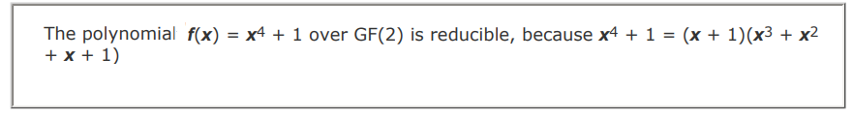
Polynomial Division
can write any polynomial in the form:
f(x) = q(x) g(x) + r(x)
can interpret r(x) as being a remainder
r(x) = f(x) mod g(x)
if have no remainder say g(x) divides f(x)
if g(x) has no divisors other than itself & 1 say it is irreducible (or prime) polynomial
arithmetic modulo of an irreducible polynomial forms a field
Notes:
Note that we can write any polynomial in the form of f(x) = q(x) g(x) + r(x), where division of f(x) by g(x) results in a quotient q(x) and remainder r(x). Can then extend the concept of divisors from the integer case, and show that the Euclidean algorithm can be extended to find the greatest common divisor of two polynomials whose coefficients are elements of a field.
Define an irreducible (or prime) polynomial as one with no divisors other than itself & 1. If compute polynomial arithmetic modulo an irreducible polynomial, this forms a finite field, and the GCD & Inverse algorithms can be adapted for it.

Slide 48
Polynomial GCD
can find greatest common divisor for polys
c(x) = GCD(a(x), b(x)) if c(x) is the poly of greatest degree which divides both a(x), b(x)
can adapt Euclid’s Algorithm to find it:
EUCLID[a(x), b(x)]
1. A(x) = a(x); B(x) = b(x)
2. if B(x) = 0 return A(x) = gcd[a(x), b(x)]
3. R(x) = A(x) mod B(x)
4. A(x) = B(x)
5. B(x) = R(x)
6. goto 2
Notes:
We can extend the analogy between polynomial arithmetic over a field and integer arithmetic by defining the greatest common divisor as shown.

Slide 49
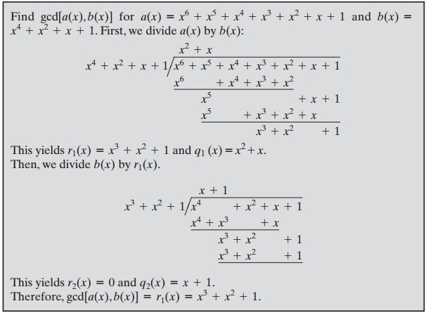
Polynomial GCD

Slide 50
3. Modular Polynomial Arithmetic
can compute in field GF(2^{n})
polynomials with coefficients modulo 2
whose degree is less than n
hence must reduce modulo an irreducible poly of degree n (for multiplication only)
form a finite field
can always find an inverse
can extend Euclid’s Inverse algorithm to find the inverse
Notes:
Consider now the case of polynomial arithmetic with coordinates mod 2 and polynomials mod an irreducible polynomial m(x). That is Modular Polynomial Arithmetic uses the set S of all polynomials of degree n-1 or less over the field Zp. With the appropriate definition of arithmetic operations, each such set S is a finite field. The definition consists of the following elements:
Arithmetic follows the ordinary rules of polynomial arithmetic using the basic rules of algebra, with the following two refinements.
2. Arithmetic on the coefficients is performed modulo p.
3. If multiplication results in a polynomial of degree greater than n-1, then the polynomial is reduced modulo some irreducible polynomial m(x) of degree n. That is, we divide by m(x) and keep the remainder.
This forms a finite field. And just as the Euclidean algorithm can be adapted to find the greatest common divisor of two polynomials, the extended Euclidean algorithm can be adapted to find the multiplicative inverse of a polynomial.

Slide 51
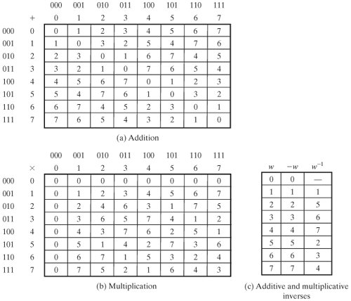
Arithmetic in Gf(2³)

Slide 52
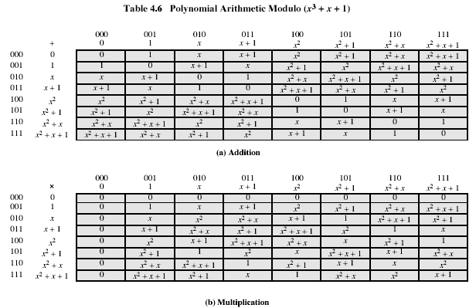
Example GF(2³)
Notes:
Example shows addition & multiplication in GF(2³) modulo (x³+x+1)

Slide 53
Computational Considerations
since coefficients are 0 or 1, can represent any such polynomial as a bit string
addition becomes XOR of these bit strings
multiplication is shift & XOR
cf long-hand multiplication
modulo reduction done by repeatedly substituting highest power with remainder of irreducible poly (also shift & XOR)
Notes:
A key motivation for using polynomial arithmetic in GF(2^{n}) is that the polynomials can be represented as a bit string, using all possible bit values, and the calculations only use simple common machine instructions - addition is just XOR, and multiplication is shifts & XOR’s. See text for additional discussion. The shortcut for polynomial reduction comes from the observation that if in GF(2^{n}) then irreducible poly g(x) has highest term x^{n} , and if compute x^{n} mod g(x) answer is g(x)- x^{n}

Slide 54
Computational Example
in GF(2³) have (x²+1) is 101₂ & (x²+x+1) is 111₂
so addition is
(x²+1) + (x²+x+1) = x
101 XOR 111 = 010₂
and multiplication is
(x+1).(x²+1) = x.(x²+1) + 1.(x²+1)
= x³+x+x²+1 = x³+x²+x+1
011.101 = (101)<<1 XOR (101)<<0 =
1010 XOR 101 = 1111₂
polynomial modulo reduction (get q(x) & r(x)) is
(x³+x²+x+1 ) mod (x³+x+1) = 1.(x³+x+1) + (x²) = x²
1111 mod 1011 = 1111 XOR 1011 = 0100₂
Notes:
Show here a few simple examples of addition, multiplication & modulo reduction in GF(2³).
Note the long form modulo reduction finds p(x)=q(x).m(x)+r(x) with r(x) being the desired remainder.

Slide 55
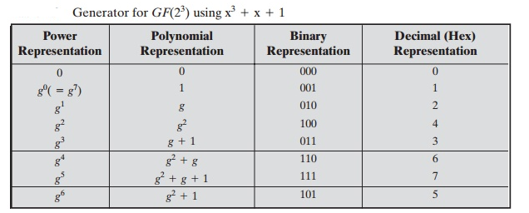
Using a Generator
a generator g is an element whose powers generate all non-zero elements
in F have 0, g⁰, g¹, …, g^{q-2}
can create generator from root of the irreducible polynomial
then implement multiplication by adding exponents of generator
Notes:
There is an equivalent technique for defining a finite field of the form GF(2^{n}) using the same irreducible polynomial, based on powers of a generator of the group, which gives a nice implementation of multiplication. The generator can be found from the root of the irreducible polynomial, as discussed in the text.

Slide 56
Summary
have considered:
concept of groups, rings, fields
modular arithmetic with integers
Euclid’s algorithm for GCD
finite fields GF(p)
polynomial arithmetic in general and in GF(2^{n})
Notes:
Chapter 4 summary.

